Slide 1
Chapter 10.1: Case Studies
The Users
MS-DOS
The System
Referances

Slide 2
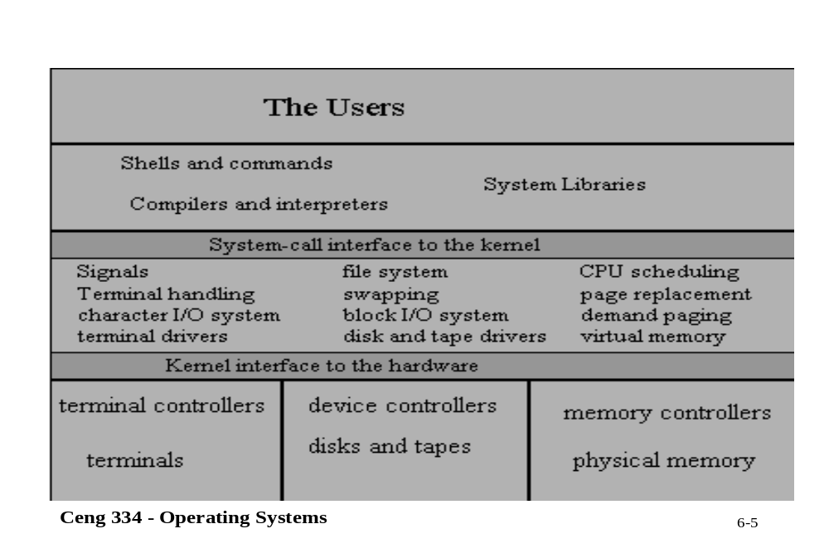
The Users

Slide 3
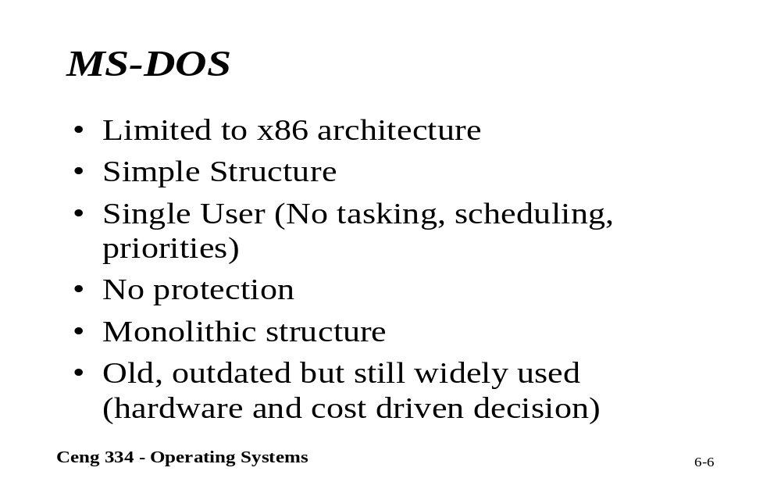
MS-DOS

Slide 4
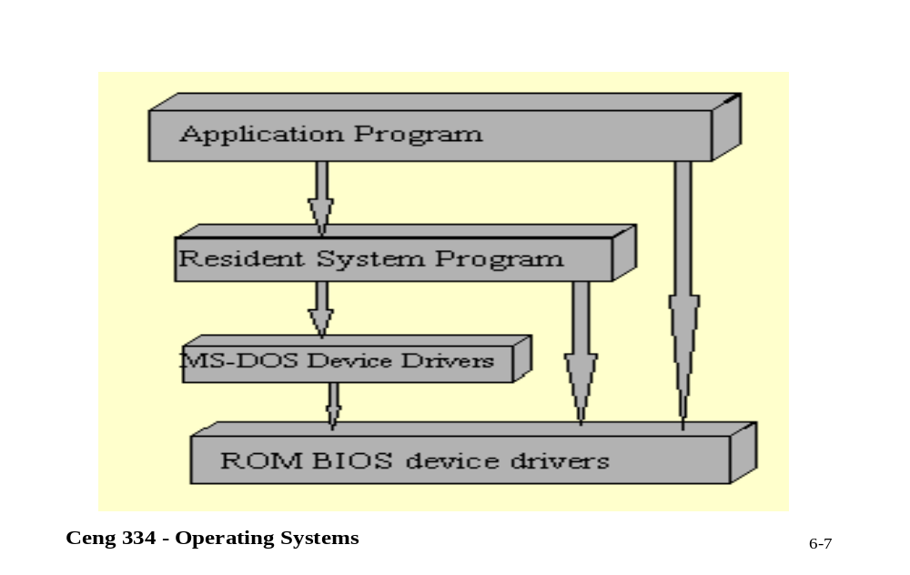
The System

Slide 5
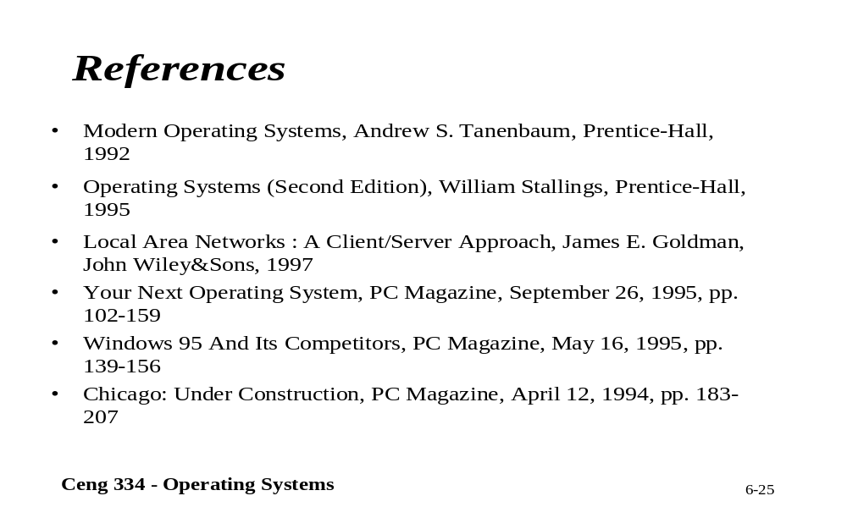
References

